Slide 1
Week 1: INTRODUCING SCRATCH

Slide 2
Introduction
Name
School
Favorite thing you’ve done so far this summer (or looking forward to do)
Notes:
Introduce instructors

Slide 3
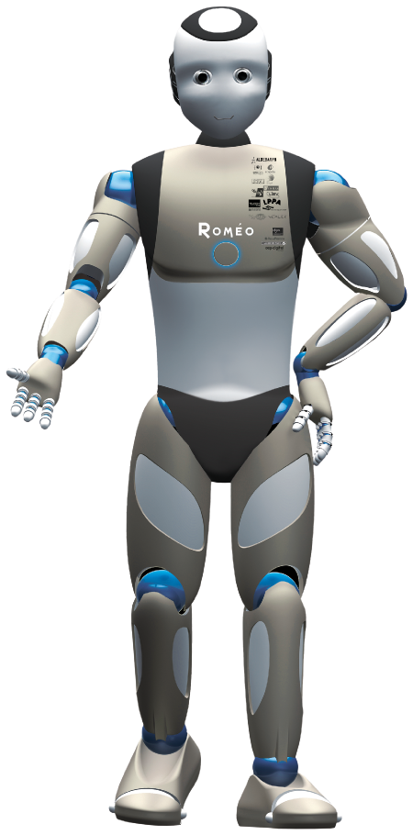
Program the robot
In pairs, assign one student to be A and the other B
For 3 minutes, A will give verbal “commands” to move or do actions, and B will act them out, or execute them
Switch roles!

Slide 4
scratch
Scratch is a coding language with a visual interface
Allows students to create projects such as stories, games, animations, and more!
Notes:
Engage students – raise hand if they have heard of or used scratch before
Sample projects:
Flappy bird:
https://scratch.mit.edu/projects/1175373249/
Flame:
https://scratch.mit.edu/projects/1125016694/
Story:
https://scratch.mit.edu/projects/1169824272/

Slide 5
Creating scratch accounts
1. Go to scratch.mit.edu
2. Join Scratch
3. Create a username and password – WRITE THEM DOWN
4. Select country – United States of America
5. Enter your birth year and month
6. Select gender (or prefer not to say)
7. Enter email address – if you don’t have one, enter your parents email!
Notes:
EMAIL ADDRESSES??

Slide 6
EXPLORING SCRATCH
Getting Started with Scratch
Spend 10 minutes exploring Scratch and playing around with projects!

Slide 7
Break
Notes:
Create a Week 1 scratch project

Slide 8
Basic commands
Notes:
Talk about how blocks connect to each other so that they execute one after another
Have to be connected to a ‘on click’ or ‘green flag’ block in order to actually execute
Go over simple basic commands, they can explore the rest later

Slide 9
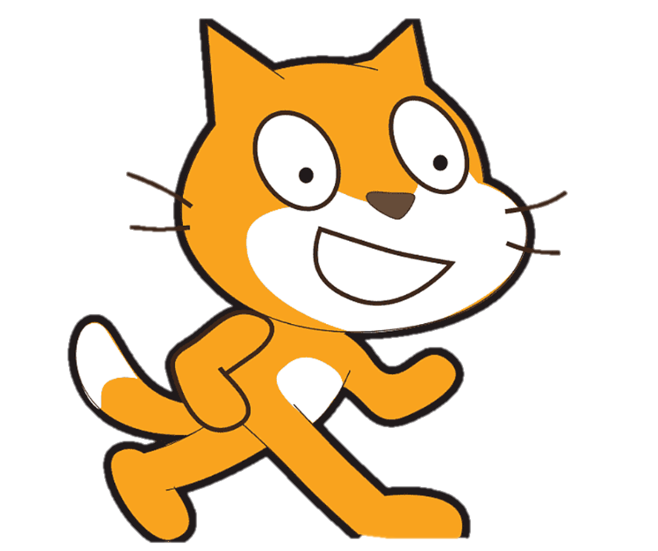
Create a sprite
Creating a Sprite
Try drawing your own sprite!
If you finish early, trying making it move around!
Notes:
Show demo, and show that you can also choose an existing sprite
Also show that each sprite has its own set of commands

Slide 10
Create a background
Creating a Background
Trying creating your own background!
If you finish early, add sprites to your background!
Notes:
Show demo, and show that you can also choose an existing sprite

Slide 11
Animated Name
Create an animation for your own name!
Use sprites for each letter of your name (in the letters category)
Example: https://scratch.mit.edu/projects/1197095557
Notes:
https://scratch.mit.edu/projects/1197095557

Slide 12
Break
Notes:
Poison dartfrog
Sharks and minows
Tag/freeze tag
Night in the museum

Slide 13
Dance Party
Create an animation that resembles a ‘Dance Party’
Example: https://scratch.mit.edu/projects/1105113583
Can work independently on in pairs

Slide 14
Reflect and journal

